Slide 1
Lecture 11 Nodal Analysis

Slide 2
Introduction
Nodal analysis is a procedure for analyzing circuits.
This procedure utilizes node voltages as circuit variables.

Slide 3

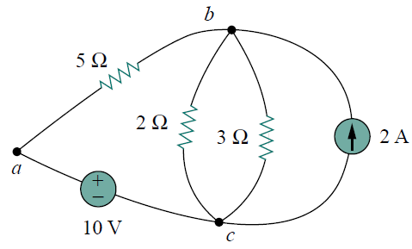
Node ????
Node
Node
Node
A Node is the point of connection between two or more branches

Slide 4
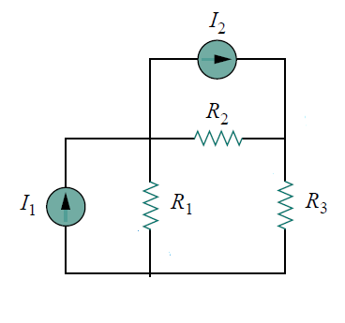
Circuit with current source
The figure shows a circuit with two current sources I₁ and I₂. The circuit also consists of 3 resistors R₁, R₂ and R₃.

Slide 5
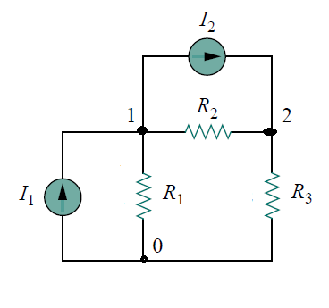
Nodes
There are 3 nodes in the circuit
Node 0, Node 1, Node 2
Lecture 11

Slide 6
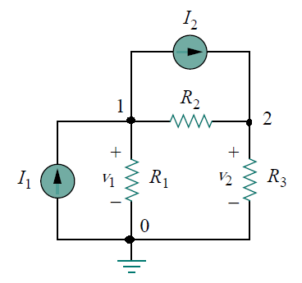
Reference Node
Node 0 is considered as reference node
Lecture 11

Slide 7
Non reference Nodes
Node 1 and Node 2 are considered to be non reference nodes
Lecture 11

Slide 8
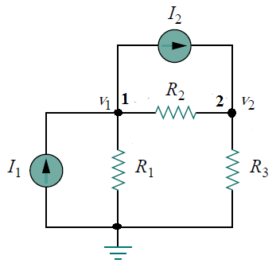
voltage at Non Reference Nodes
v₁ and v₂ are voltages at nodes 1 and 2 respectively
Lecture 11

Slide 9
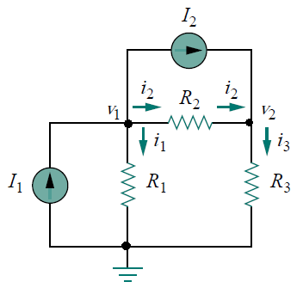
Current flow in a resistor
i = (v_{higher} − v_{lower})/R
i₁ = (v₁ − 0)/R₁
i₂ = (v₁ − v₂)/R₂
i₃ = (v₂ − 0)/R₃
Lecture 11

Slide 10

Application of K. C. L. at Node 1
Applying K. C. L. at node 1: I₁= i₁+ i₂ +I₂ --(1)
Lecture 11

Slide 11
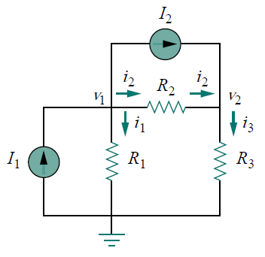
i₁ = (v₁ − 0)/R₁
i₂ = (v₁ − v₂)/R₂
i₃ = (v₂ − 0)/R₃
I₁= i₁+ i₂ + I₂------(1)
I₁- I₂= (v₁ − 0)/R₁+ (v₁ − v₂)/R₂
----------------- (2)
Lecture 11

Slide 12

Application of K. C. L. at Node 2
Applying K. C. L. at node 2: I₂ + i₂= i₃ ------ (3)
i₁ = (v₁ − 0)/R₁
i₂ = (v₁ − v₂)/R₂
i₃ = (v₂ − 0)/R₃
I₂+(v₁ − v₂)/R₂= (v₂ − 0)/R₃--------------(4)
Lecture 11

Slide 13
I₁- I₂= (v₁ − 0)/R₁+ (v₁ − v₂)/R₂
------------- (2)
I₂+(v₁ − v₂)/R₂= (v₂ − 0)/R₃ --------------(4)
On solving (2) and (4) v₁ and v₂ is calculated. Once v₁ and v₂ is calculated current flowing through all resistances can be calculated.
Lecture 11

Slide 14
Calculate the current In R₁, R₂ and R₃ in the circuit shown in figure
The value of the resistances is given
I₁ = 4A
I₂ = 6A
R₁=10Ω
R₂=5 Ω
R₃=20 Ω
Lecture 11

Slide 15
I₁- I₂ = (v₁ − 0)/R₁+ (v₁ − v₂)/R₂-------- (2)
Equation (2)( Node1 equation)
I₂+(v₁ − v₂)/R₂= (v₂ − 0)/R₃ --------------(4)
Equation (4)(Node2 equation
I₁ = 4A
I₂ = 6A
R₁=10Ω
R₂=5 Ω
R₃=20 Ω
Lecture 11

Slide 16
I₁- I₂ = (v₁ − 0)/R₁+ (v₁ − v₂)/R₂
------------- (2)
I₂+(v₁ − v₂)/R₂= (v₂ − 0)/R₃ --------------(4)
I₁ = 4A
I₂ = 6A
R₁=10Ω
R₂=5 Ω
R₃=20 Ω
4-6= (v₁ − 0)/10+ (v₁ − v₂)/5
------------- (2)
-2= v₁ /10+ (v₁ − v₂)/5------(5)
Lecture 11

Slide 17
From previous slide equation(5) is obtained for Node 1
I₁ = 4A
I₂ = 6A
R₁=10Ω
R₂=5 Ω
R₃=20 Ω
-2= v₁ /10+ (v₁ − v₂)/5------(5)
Multiply (5) by 10
-20= v₁+ 2*(v₁ − v₂)
-20= v₁+ 2*v₁−2*v₂
3*v₁−2*v₂= -20--------------(6)
Lecture 11

Slide 18
3*v₁−2*v₂= -20--------------(6)
At Node 2 from equation (4)
I₂+(v₁ − v₂)/R₂= (v₂ − 0)/R₃ ---------(4)
6+(v₁ − v₂)/5= (v₂)/20 ----------------(7)
Multiply (7) by 20
120+4*v₁ − 4*v₂= v₂
-4*v₁+ 5*v₂=120-----------------(8)
Solving (6) and (8)
v₁ = 140/7= 20v
Sub v₁ in equation (6)
3*(20)−2*v₂= -20--------------(6)
v₂=(80/2)=40V
Lecture 11

Slide 19
i₁ = (v₁ − 0)/R₁
i₂ = (v₁ − v₂)/R₂
i₃ = (v₂ − 0)/R₃
R₁=10Ω
R₂=5 Ω
R₃=20 Ω
v₁ = 20v
v₂=40V
i₁= (20-0)/10=2A
i₂=((20-40)/5)=-4A(negative sign indicate current direction is opposite to assumed direction of current.
i₃=((40-0)/20)=2A
Lecture 11

Slide 20
Thank You

